Slide 1
Announcements
HW2 is due on 2/26/19
Midterm 1 will be on 2/28/19. Covers everything we’ve seen so far (including today).
A Practice Midterm will be posted on iLearn.

Slide 2

Warm-up Activity
On which graph will DFS run faster?
B
C
B
C
A
A
D
D
H
H
E
E
G
F
G
F

Slide 3
CST 370 – ADVANCED ALGORITHMS
10.1 Complexity Analysis on Graphs

Slide 4
Objectives
You will be able to…
Identify the space complexity for representing a graph.
Represent a graph in an Adjacency Matrix.
Identify why graph operations have different time complexities based on their representations.
Identify the Time and Space complexity of BFS, DFS, mDFS, and Khan’s algorithm.

Slide 5
Adjacency List
A Nodes based graph representation
struct GraphNode {
string data;
vector<GraphNode *> neighbors;
};
struct Graph {
vector<GraphNode *> verticies;
};

Slide 6
Adjacency List
A Nodes based graph representation
How much space does it take to represent a graph with an adjacency list?
struct GraphNode {
string data;
vector<GraphNode *> neighbors;
};
struct Graph {
vector<GraphNode *> verticies;
};

Slide 7
Adjacency List
Which graph takes more memory to represent?
B
C
B
C
A
A
D
D
H
H
E
E
G
F
G
F

Slide 8
Adjacency List
A Nodes based graph representation
How much space does it take to represent a graph with an adjacency list?
O(n + e)
n = # nodes in total
e = # edges in total
struct GraphNode {
string data;
vector<GraphNode *> neighbors;
};
struct Graph {
vector<GraphNode *> verticies;
};

Slide 9
Adjacency List: hasEdge
Operations on an Adjacency List
How much time does it take to check if an edge from A -> B exists?
struct GraphNode {
string data;
vector<GraphNode *> neighbors;
};
struct Graph {
vector<GraphNode *> verticies;
};

Slide 10
Adjacency List: hasEdge
Operations on an Adjacency List
How much time does it take to check if an edge from A -> B exists?
O(n)
n = # nodes in total
struct GraphNode {
string data;
vector<GraphNode *> neighbors;
};
struct Graph {
vector<GraphNode *> verticies;
};

Slide 11
Adjacency List: getNeighbors
Operations on an Adjacency List
How much time does it take to get all the neighbors of an edge?
struct GraphNode {
string data;
vector<GraphNode *> neighbors;
};
struct Graph {
vector<GraphNode *> verticies;
};

Slide 12
Adjacency List: getNeighbors
Operations on an Adjacency List
How much time does it take to get all the neighbors of an edge?
O(1)
struct GraphNode {
string data;
vector<GraphNode *> neighbors;
};
struct Graph {
vector<GraphNode *> verticies;
};

Slide 13
Adjacency List
A Nodes based graph representation
The amount of memory needed to represent a graph as an Adjacency List grows as we add more edges.
Is there a representation where that doesn’t happen?

Slide 14
Adjacency Matrix
A matrix-based representation.
An Adjacency Matrix represents graphs as a NxN matrix and a Vertices List.
0 1 2 3 4
0 | 1 | 0 | 1 | 1
1 | 0 | 1 | 1 | 1
0 | 1 | 0 | 0 | 0
1 | 1 | 0 | 0 | 1
1 | 1 | 0 | 1 | 0
0
1
2
3
4
8 | 12 | 90 | 55 | 3
Edges
0 1 2 3 4
Vertices

Slide 15
Adjacency Matrix
A matrix-based representation.
struct Vertex {
string data;
};
vector<Vertex> vertcies;
vector<vector<int>> edges;

Slide 16
Adjacency Matrix
A matrix-based representation.
struct Vertex {
string data;
};
vector<Vertex> vertcies;
vector<vector<bool>> edges;

Slide 17
Adjacency Matrix
A matrix-based representation.
struct Vertex {
string data;
};
vector<Vertex> vertcies;
vector<vector<int>> edges;
How much space does it take to represent a graph with an adjacency list?

Slide 18
Adjacency Matrix
A matrix-based representation.
struct Vertex {
string data;
};
vector<Vertex> vertcies;
vector<vector<int>> edges;
How much space does it take to represent a graph with an adjacency list?
O(n^2)
n = # nodes in total

Slide 19
Adjacency Matrix
A matrix-based representation.
struct Vertex {
string data;
};
vector<Vertex> vertcies;
vector<vector<int>> edges;
How much space does it take to represent a graph with an adjacency list?
O(n^2)
n = # nodes in total

Slide 20
Adjacency Matrix
A matrix-based representation.
vector<Node> vertices;
vector<vector<int>> edges;
0 1 2 3 4
0 | 1 | 0 | 1 | 1
1 | 0 | 1 | 1 | 1
0 | 1 | 0 | 0 | 0
1 | 1 | 0 | 0 | 1
1 | 1 | 0 | 1 | 0
0
1
2
3
4
A | B | C | D | E
0 1 2 3 4

Slide 21
Adjacency Matrix: hasEdge
Operations on an Adjacency Matrix
0 1 2 3 4
0 | 1 | 0 | 1 | 1
1 | 0 | 1 | 1 | 1
0 | 1 | 0 | 0 | 0
1 | 1 | 0 | 0 | 1
1 | 1 | 0 | 1 | 0
0
1
2
3
4
A | B | C | D | E
0 1 2 3 4
return M[i][j] == 1
O(1).

Slide 22
Adjacency Matrix: getNeighbors
Operations on an Adjacency Matrix
0 1 2 3 4
0 | 1 | 0 | 1 | 1
1 | 0 | 1 | 1 | 1
0 | 1 | 0 | 0 | 0
1 | 1 | 0 | 0 | 1
1 | 1 | 0 | 1 | 0
0
1
2
3
4
A | B | C | D | E
0 1 2 3 4
Check the whole row.
O(n). n = # nodes in total

Slide 23
Which representation is better?
It Depends.
Adjacency Matrix:
Good for graphs with lots of edges. (Dense Graphs)
Looking up if an edge exists is fast: O(1)
Getting Adjacent nodes isn’t fast: O(n)
Adjacency List:
Good for graphs without lots of edges (Sparse Graphs)
Looking up if an edge exists isn’t fast: O(n)
Getting the adjacent nodes is fast: O(1)
Most graphs are sparse :)

Slide 24
Complexity of Graph Algorithms
The algorithms we’ve seen so far
Graph Traversal Algorithms:
Breadth First Search (BFS)
Depth First Search (DFS)
Topological Sorting Algorithms:
Modified Depth First Search (mDFS)
Khan’s Algorithm (Khan’s)

Slide 25
Breadth First Search
A Review:
Process:
Create a queue to store which nodes to check next.
For every node in the Graph:
If that node has not been visited, add it to the queue and mark as visited.
While the queue is not empty:
dequeue an element from the queue.
For every neighbor of that node, check if it’s been visited.
If not, add it to the queue and mark as visited.

Slide 26
Graph Traversals
BFS Example
Stephanie
Zuck
Noah
Lilly
Dunni
Diane
Emma
Elena
Alex
Alex
Danielle
Agnieszka
Jess
Todd
Brandi
Kristen
Liz
Shannon

Slide 27
Graph Traversals
BFS Example
Stephanie
Zuck
Noah
Lilly
Dunni
Diane
Emma
Elena
Alex
Alex
Danielle
Agnieszka
Jess
Todd
Brandi
Kristen
Liz
Shannon

Slide 28
Graph Traversals
BFS Example
Stephanie
Zuck
Noah
Lilly
Dunni
Diane
Emma
Elena
Alex
Alex
Danielle
Agnieszka
Jess
Todd
Brandi
Kristen
Liz
Shannon

Slide 29
Graph Traversals
BFS Example
Stephanie
Zuck
Noah
Lilly
Dunni
Diane
Emma
Elena
Alex
Alex
Danielle
Agnieszka
Jess
Todd
Brandi
Kristen
Liz
Shannon

Slide 30
Graph Traversals
BFS Example
Stephanie
Zuck
Noah
Lilly
Dunni
Diane
Emma
Elena
Alex
Alex
Danielle
Agnieszka
Jess
Todd
Brandi
Kristen
Liz
Shannon

Slide 31
Graph Traversals
BFS Example
Stephanie
Zuck
Noah
Lilly
Dunni
Diane
Emma
Elena
Alex
Alex
Danielle
Agnieszka
Jess
Todd
Brandi
Kristen
Liz
Shannon

Slide 32
Graph Traversals
BFS Example
Stephanie
Zuck
Noah
Lilly
Dunni
Diane
Emma
Elena
Alex
Alex
Danielle
Agnieszka
Jess
Todd
Brandi
Kristen
Liz
Shannon

Slide 33
Graph Traversals
BFS Example
Stephanie
Zuck
Noah
Lilly
Dunni
Diane
Emma
Elena
Alex
Alex
Danielle
Agnieszka
Jess
Todd
Brandi
Kristen
Liz
Shannon

Slide 34
Graph Traversals
BFS Example
Stephanie
Zuck
Noah
Lilly
Dunni
Diane
Emma
Elena
Alex
Alex
Danielle
Agnieszka
Jess
Todd
Brandi
Kristen
Liz
Shannon

Slide 35
Graph Traversals
BFS Example
Stephanie
Zuck
Noah
Lilly
Dunni
Diane
Emma
Elena
Alex
Alex
Danielle
Agnieszka
Jess
Todd
Brandi
Kristen
Liz
Shannon

Slide 36
Graph Traversals
BFS Example
Stephanie
Zuck
Noah
Lilly
Dunni
Diane
Emma
Elena
Alex
Alex
Danielle
Agnieszka
Jess
Todd
Brandi
Kristen
Liz
Shannon

Slide 37
Graph Traversals
BFS Example
Stephanie
Zuck
Noah
Lilly
Dunni
Diane
Emma
Elena
Alex
Alex
Danielle
Agnieszka
Jess
Todd
Brandi
Kristen
Liz
Shannon

Slide 38
Graph Traversals
BFS Example
Stephanie
Zuck
Noah
Lilly
Dunni
Diane
Emma
Elena
Alex
Alex
Danielle
Agnieszka
Jess
Todd
Brandi
Kristen
Liz
Shannon

Slide 39
Graph Traversals
BFS Example
Stephanie
Zuck
Noah
Lilly
Dunni
Diane
Emma
Elena
Alex
Alex
Danielle
Agnieszka
Jess
Todd
Brandi
Kristen
Liz
Shannon

Slide 40
Graph Traversals
BFS Example
Stephanie
Zuck
Noah
Lilly
Dunni
Diane
Emma
Elena
Alex
Alex
Danielle
Agnieszka
Jess
Todd
Brandi
Kristen
Liz
Shannon

Slide 41
Graph Traversals
BFS Example
Stephanie
Zuck
Noah
Lilly
Dunni
Diane
Emma
Elena
Alex
Alex
Danielle
Agnieszka
Jess
Todd
Brandi
Kristen
Liz
Shannon

Slide 42
Breadth First Search: Complexity
Time and Space.
n = # nodes in total
e = # edges in total
Time: O(n+e). We follow every edge and visit every node.
Space: O(n). We store up to n nodes in the queue.

Slide 43
Depth First Search (iterative)
A Review:
Process:
Create a stack to store which nodes to check next.
For every node in the Graph:
If that node has not been visited, add it to the stack and mark as visited.
While the stack is not empty:
pop an element from the stack.
For every neighbor of that node, check if it’s been visited.
If not, add it to the stack and mark as visited.

Slide 44
Depth First Search (recursive)
A Review:
Process:
For every node in the Graph:
If that node has not been visited, mark it as visited and call the recursive DFS helper on it.
In the recursive DFS helper, for every neighbor of the current node:
if that node has not been visited, mark it as visited and recursively call the DFS helper on that neighbor.

Slide 45
Graph Traversals
DFS Example
Stephanie
Zuck
Noah
Lilly
Dunni
Diane
Emma
Elena
Alex
Alex
Danielle
Agnieszka
Jess
Todd
Brandi
Kristen
Liz
Shannon

Slide 46
Graph Traversals
DFS Example
Stephanie
Zuck
Noah
Lilly
Dunni
Diane
Emma
Elena
Alex
Alex
Danielle
Agnieszka
Jess
Todd
Brandi
Kristen
Liz
Shannon

Slide 47
Graph Traversals
DFS Example
Stephanie
Zuck
Noah
Lilly
Dunni
Diane
Emma
Elena
Alex
Alex
Danielle
Agnieszka
Jess
Todd
Brandi
Kristen
Liz
Shannon

Slide 48
Graph Traversals
DFS Example
Stephanie
Zuck
Noah
Lilly
Dunni
Diane
Emma
Elena
Alex
Alex
Danielle
Agnieszka
Jess
Todd
Brandi
Kristen
Liz
Shannon

Slide 49
Graph Traversals
DFS Example
Stephanie
Zuck
Noah
Lilly
Dunni
Diane
Emma
Elena
Alex
Alex
Danielle
Agnieszka
Jess
Todd
Brandi
Kristen
Liz
Shannon

Slide 50
Graph Traversals
DFS Example
Stephanie
Zuck
Noah
Lilly
Dunni
Diane
Emma
Elena
Alex
Alex
Danielle
Agnieszka
Jess
Todd
Brandi
Kristen
Liz
Shannon

Slide 51
Graph Traversals
DFS Example
Stephanie
Zuck
Noah
Lilly
Dunni
Diane
Emma
Elena
Alex
Alex
Danielle
Agnieszka
Jess
Todd
Brandi
Kristen
Liz
Shannon

Slide 52
Graph Traversals
DFS Example
Stephanie
Zuck
Noah
Lilly
Dunni
Diane
Emma
Elena
Alex
Alex
Danielle
Agnieszka
Jess
Todd
Brandi
Kristen
Liz
Shannon

Slide 53
Graph Traversals
DFS Example
Stephanie
Zuck
Noah
Lilly
Dunni
Diane
Emma
Elena
Alex
Alex
Danielle
Agnieszka
Jess
Todd
Brandi
Kristen
Liz
Shannon

Slide 54
Graph Traversals
DFS Example
Stephanie
Zuck
Noah
Lilly
Dunni
Diane
Emma
Elena
Alex
Alex
Danielle
Agnieszka
Jess
Todd
Brandi
Kristen
Liz
Shannon

Slide 55
Graph Traversals
DFS Example
Stephanie
Zuck
Noah
Lilly
Dunni
Diane
Emma
Elena
Alex
Alex
Danielle
Agnieszka
Jess
Todd
Brandi
Kristen
Liz
Shannon

Slide 56
Graph Traversals
DFS Example
Stephanie
Zuck
Noah
Lilly
Dunni
Diane
Emma
Elena
Alex
Alex
Danielle
Agnieszka
Jess
Todd
Brandi
Kristen
Liz
Shannon

Slide 57
Graph Traversals
DFS Example
Stephanie
Zuck
Noah
Lilly
Dunni
Diane
Emma
Elena
Alex
Alex
Danielle
Agnieszka
Jess
Todd
Brandi
Kristen
Liz
Shannon

Slide 58
Graph Traversals
DFS Example
Stephanie
Zuck
Noah
Lilly
Dunni
Diane
Emma
Elena
Alex
Alex
Danielle
Agnieszka
Jess
Todd
Brandi
Kristen
Liz
Shannon

Slide 59
Graph Traversals
DFS Example
Stephanie
Zuck
Noah
Lilly
Dunni
Diane
Emma
Elena
Alex
Alex
Danielle
Agnieszka
Jess
Todd
Brandi
Kristen
Liz
Shannon

Slide 60
Graph Traversals
DFS Example
Stephanie
Zuck
Noah
Lilly
Dunni
Diane
Emma
Elena
Alex
Alex
Danielle
Agnieszka
Jess
Todd
Brandi
Kristen
Liz
Shannon

Slide 61
Depth First Search: Complexity
Time and Space.
n = # nodes in total
e = # edges in total
Time: O(n+e). We follow every edge and visit every node.
Space: O(n). We store up to n nodes in the stack.
O(1) explicit space in the recursive implementation.

Slide 62
Topological Sorting
Implementation
Two Methods:
Modified DFS
Kahn’s Algorithm
Notes:
https://www.geeksforgeeks.org/topological-sorting/
https://www.geeksforgeeks.org/topological-sorting-indegree-based-solution/

Slide 63
Topological Sorting: mDFS
A Review:
Process:
Create a stack for storing vertices for our topological sort.
For every node in the Graph:
If that node has not been visited, mark it as visited and call the recursive DFS helper on it.
In the recursive DFS helper, for every neighbor of the current node:
if that node has not been visited, mark it as visited and recursively call the DFS helper on that neighbor.
After you’ve recursed on every neighbor, push that node onto the stack.
After visiting every node. Pop values off the stack to produce a topological sort

Slide 64
Topological Sorting
Modified DFS Example
B
C
Current node
Current path
Visited node
A
D
H
E
G
F

Slide 65
Topological Sorting
Modified DFS Example
B
C
Current node
Current path
Visited node
A
D
H
E
G
F

Slide 66
Topological Sorting
Modified DFS Example
B
C
Current node
Current path
Visited node
A
D
H
E
G
F

Slide 67
Topological Sorting
Modified DFS Example
B
B
C
Current node
Current path
Visited node
A
D
H
E
G
F

Slide 68
Topological Sorting
Modified DFS Example
B
B
C
Current node
Current path
Visited node
A
D
H
E
G
F

Slide 69
Topological Sorting
Modified DFS Example
G
B
B
C
Current node
Current path
Visited node
A
D
H
E
G
F

Slide 70
Topological Sorting
Modified DFS Example
D
G
B
B
C
Current node
Current path
Visited node
A
D
H
E
G
F

Slide 71
Topological Sorting
Modified DFS Example
A
D
G
B
B
C
Current node
Current path
Visited node
A
D
H
E
G
F

Slide 72
Topological Sorting
Modified DFS Example
A
D
G
B
B
C
Current node
Current path
Visited node
A
D
H
E
G
F

Slide 73
Topological Sorting
Modified DFS Example
A
D
G
B
B
C
Current node
Current path
Visited node
A
D
H
E
G
F

Slide 74
Topological Sorting
Modified DFS Example
E
A
D
G
B
B
C
Current node
Current path
Visited node
A
D
H
E
G
F

Slide 75
Topological Sorting
Modified DFS Example
F
E
A
D
G
B
B
C
Current node
Current path
Visited node
A
D
H
E
G
F

Slide 76
Topological Sorting
Modified DFS Example
H
F
E
A
D
G
B
B
C
Current node
Current path
Visited node
A
D
H
E
G
F

Slide 77
Topological Sorting
Modified DFS Example
C
H
F
E
A
D
G
B
B
C
Current node
Current path
Visited node
A
D
H
E
G
F

Slide 78
mDFS: Complexity
Time and Space.
n = # nodes in total
e = # edges in total
Time: O(n+e). We follow every edge and visit every node.
Space: O(n). We store n nodes in the stack.

Slide 79
Topological Sorting: Kahn’s
A Review:
Process:
Compute the in-degrees for every node in the graph.
Create a queue and enqueue every node with in-degree 0.
While the queue is not empty:
Dequeue a node from the queue.
For each of that node’s neighbors, decrement it’s in-degree.
If the neighbor’s in-degree is now 0, enqueue it.
Print that node in our topological sort.

Slide 80
Topological Sorting
Implementation: Kahn’s Algorithm
B
C
A | B | C | D | E | F | G | H
A
D
H
E
G
F

Slide 81
Topological Sorting
Implementation: Kahn’s Algorithm
B
C
A | B | C | D | E | F | G | H
0
A
D
H
E
G
F

Slide 82
Topological Sorting
Implementation: Kahn’s Algorithm
B
C
A | B | C | D | E | F | G | H
0 | 1
A
D
H
E
G
F

Slide 83
Topological Sorting
Implementation: Kahn’s Algorithm
B
C
A | B | C | D | E | F | G | H
0 | 1 | 0
A
D
H
E
G
F

Slide 84
Topological Sorting
Implementation: Kahn’s Algorithm
B
C
A | B | C | D | E | F | G | H
0 | 1 | 0 | 2
A
D
H
E
G
F

Slide 85
Topological Sorting
Implementation: Kahn’s Algorithm
B
C
A | B | C | D | E | F | G | H
0 | 1 | 0 | 2 | 1
A
D
H
E
G
F

Slide 86
Topological Sorting
Implementation: Kahn’s Algorithm
B
C
A | B | C | D | E | F | G | H
0 | 1 | 0 | 2 | 1 | 1
A
D
H
E
G
F

Slide 87
Topological Sorting
Implementation: Kahn’s Algorithm
B
C
A | B | C | D | E | F | G | H
0 | 1 | 0 | 2 | 1 | 1 | 2
A
D
H
E
G
F

Slide 88
Topological Sorting
Implementation: Kahn’s Algorithm
B
C
A | B | C | D | E | F | G | H
0 | 1 | 0 | 2 | 1 | 1 | 2 | 1
A
D
H
E
G
F

Slide 89
Topological Sorting
Implementation: Kahn’s Algorithm
B
C
A | B | C | D | E | F | G | H
0 | 1 | 0 | 2 | 1 | 1 | 2 | 1
A
D
H
A | C
E
G
F

Slide 90
Topological Sorting
Implementation: Kahn’s Algorithm
B
C
A | B | C | D | E | F | G | H
0 | 1 | 0 | 2 | 1 | 1 | 2 | 1
A
D
H
A | C
E
G
F

Slide 91
Topological Sorting
Implementation: Kahn’s Algorithm
B
C
A | B | C | D | E | F | G | H
0 | 0 | 0 | 1 | 1 | 1 | 2 | 1
A
D
H
A | C
E
G
F

Slide 92
Topological Sorting
Implementation: Kahn’s Algorithm
B
C
A | B | C | D | E | F | G | H
0 | 0 | 0 | 1 | 1 | 1 | 2 | 1
A
D
H
 | C | B
E
G
F
A

Slide 93
Topological Sorting
Implementation: Kahn’s Algorithm
B
C
A | B | C | D | E | F | G | H
0 | 0 | 0 | 1 | 1 | 1 | 2 | 1
A
D
H
 | C | B
E
G
F
A

Slide 94
Topological Sorting
Implementation: Kahn’s Algorithm
B
C
A | B | C | D | E | F | G | H
0 | 0 | 0 | 0 | 1 | 1 | 1 | 0
A
D
H
 | C | B
E
G
F
A

Slide 95
Topological Sorting
Implementation: Kahn’s Algorithm
B
C
A | B | C | D | E | F | G | H
0 | 0 | 0 | 0 | 1 | 1 | 1 | 0
A
D
H
 |  | B | D | H
E
G
F
A | C

Slide 96
Topological Sorting
Implementation: Kahn’s Algorithm
B
C
A | B | C | D | E | F | G | H
0 | 0 | 0 | 0 | 1 | 1 | 1 | 0
A
D
H
 |  | B | D | H
E
G
F
A | C

Slide 97
Topological Sorting
Implementation: Kahn’s Algorithm
B
C
A | B | C | D | E | F | G | H
0 | 0 | 0 | 0 | 1 | 1 | 1 | 0
A
D
H
 |  |  | D | H
E
G
F
A | C | B

Slide 98
Topological Sorting
Implementation: Kahn’s Algorithm
B
C
A | B | C | D | E | F | G | H
0 | 0 | 0 | 0 | 1 | 1 | 1 | 0
A
D
H
 |  |  | D | H
E
G
F
A | C | B

Slide 99
Topological Sorting
Implementation: Kahn’s Algorithm
B
C
A | B | C | D | E | F | G | H
0 | 0 | 0 | 0 | 1 | 1 | 0 | 0
A
D
H
 |  |  | D | H
E
G
F
A | C | B

Slide 100
Topological Sorting
Implementation: Kahn’s Algorithm
B
C
A | B | C | D | E | F | G | H
0 | 0 | 0 | 0 | 1 | 1 | 0 | 0
A
D
H
 |  |  |  | H | G
E
G
F
A | C | B | D

Slide 101
Topological Sorting
Implementation: Kahn’s Algorithm
B
C
A | B | C | D | E | F | G | H
0 | 0 | 0 | 0 | 1 | 1 | 0 | 0
A
D
H
 |  |  |  | H | G
E
G
F
A | C | B | D

Slide 102
Topological Sorting
Implementation: Kahn’s Algorithm
B
C
A | B | C | D | E | F | G | H
0 | 0 | 0 | 0 | 0 | 0 | 0 | 0
A
D
H
 |  |  |  | H | G
E
G
F
A | C | B | D

Slide 103
Topological Sorting
Implementation: Kahn’s Algorithm
B
C
A | B | C | D | E | F | G | H
0 | 0 | 0 | 0 | 0 | 0 | 0 | 0
A
D
H
 |  |  |  |  | G | E | F
E
G
F
A | C | B | D | H

Slide 104
Topological Sorting
Implementation: Kahn’s Algorithm
B
C
A | B | C | D | E | F | G | H
0 | 0 | 0 | 0 | 0 | 0 | 0 | 0
A
D
H
 |  |  |  |  | G | E | F
E
G
F
A | C | B | D | H

Slide 105
Topological Sorting
Implementation: Kahn’s Algorithm
B
C
A | B | C | D | E | F | G | H
0 | 0 | 0 | 0 | 0 | 0 | 0 | 0
A
D
H
 |  |  |  |  |  | E | F
E
G
F
A | C | B | D | H | G

Slide 106
Topological Sorting
Implementation: Kahn’s Algorithm
B
C
A | B | C | D | E | F | G | H
0 | 0 | 0 | 0 | 0 | 0 | 0 | 0
A
D
H
 |  |  |  |  |  | E | F
E
G
F
A | C | B | D | H | G

Slide 107
Topological Sorting
Implementation: Kahn’s Algorithm
B
C
A | B | C | D | E | F | G | H
0 | 0 | 0 | 0 | 0 | 0 | 0 | 0
A
D
H
 |  |  |  |  |  |  | F
E
G
F
A | C | B | D | H | G | E

Slide 108
Topological Sorting
Implementation: Kahn’s Algorithm
B
C
A | B | C | D | E | F | G | H
0 | 0 | 0 | 0 | 0 | 0 | 0 | 0
A
D
H
 |  |  |  |  |  |  | F
E
G
F
A | C | B | D | H | G | E

Slide 109
Topological Sorting
Implementation: Kahn’s Algorithm
B
C
A | B | C | D | E | F | G | H
0 | 0 | 0 | 0 | 0 | 0 | 0 | 0
A
D
H
E
G
F
A | C | B | D | H | G | E | F

Slide 110
Topological Sorting
Implementation: Kahn’s Algorithm
B
C
A | B | C | D | E | F | G | H
0 | 0 | 0 | 0 | 0 | 0 | 0 | 0
A
D
H
E
G
F
A | C | B | D | H | G | E | F

Slide 111
Khan’s Algorithm: Complexity
Time and Space.
n = # nodes in total
e = # edges in total
Time: O(n+e). We visit every node and follow every edge when decrementing the in-degrees.
Space: O(n). We store up to n nodes in the queue.

Slide 112
Break!
More graph algorithms after the break.

Slide 113
CST 370 – ADVANCED ALGORITHMS
10.2 Graph Coloring

Slide 114
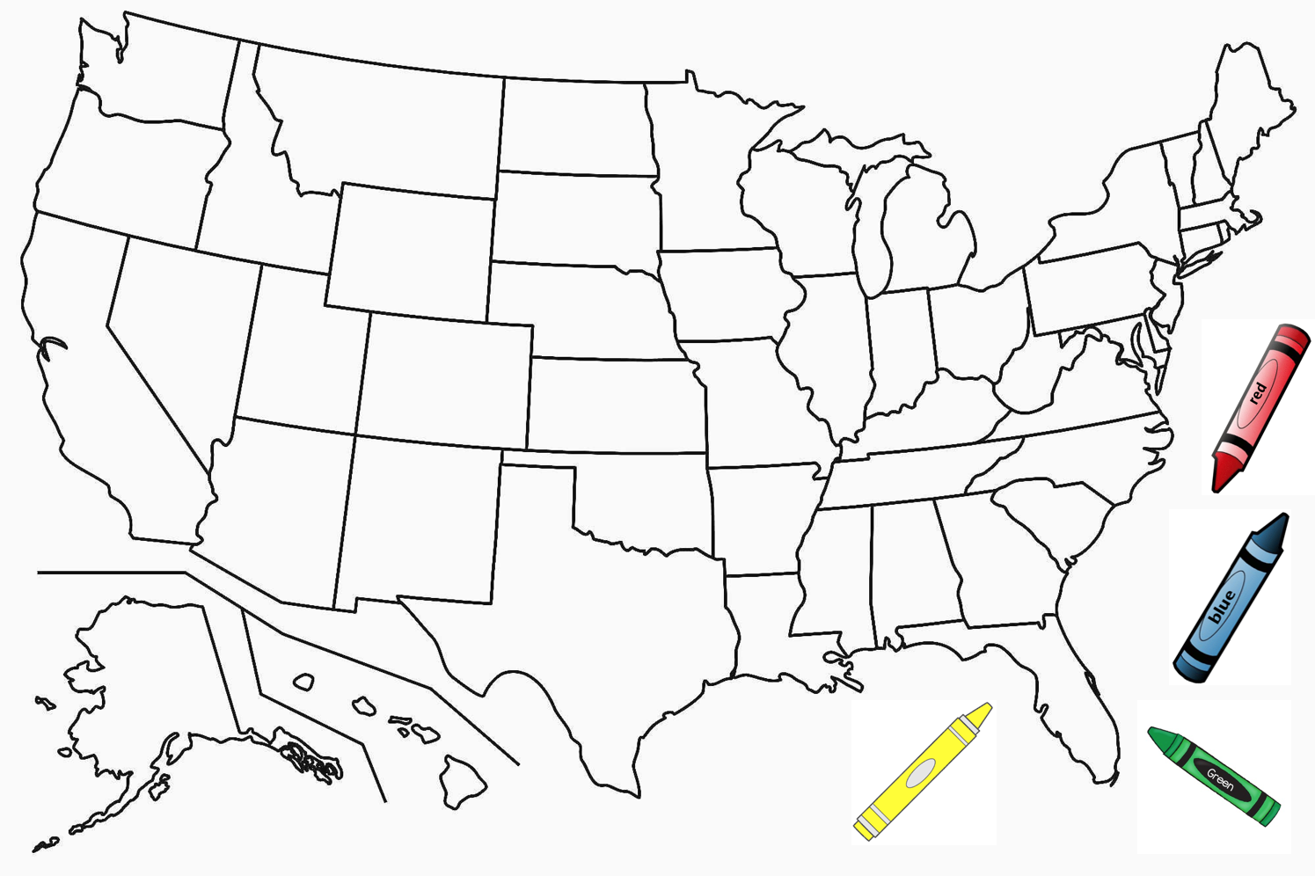
Lets go back to Kindergarten...

Slide 115
Objectives
You will be able to…
Define the vertex and edge coloring of a graph.
Identify real-world problems that can be solved using graph coloring.
Explain an algorithm for defining a graph coloring with ‘v’ colors.

Slide 116
Graph Coloring
What is it?
It is the act of coloring a graph such that no edge connects two vertices of the same color.

Slide 117
Graph Coloring: Why?
Some use cases for graph coloring.
Coloring geographical maps.
Scheduling exams.
Scheduling sports games.

Slide 118
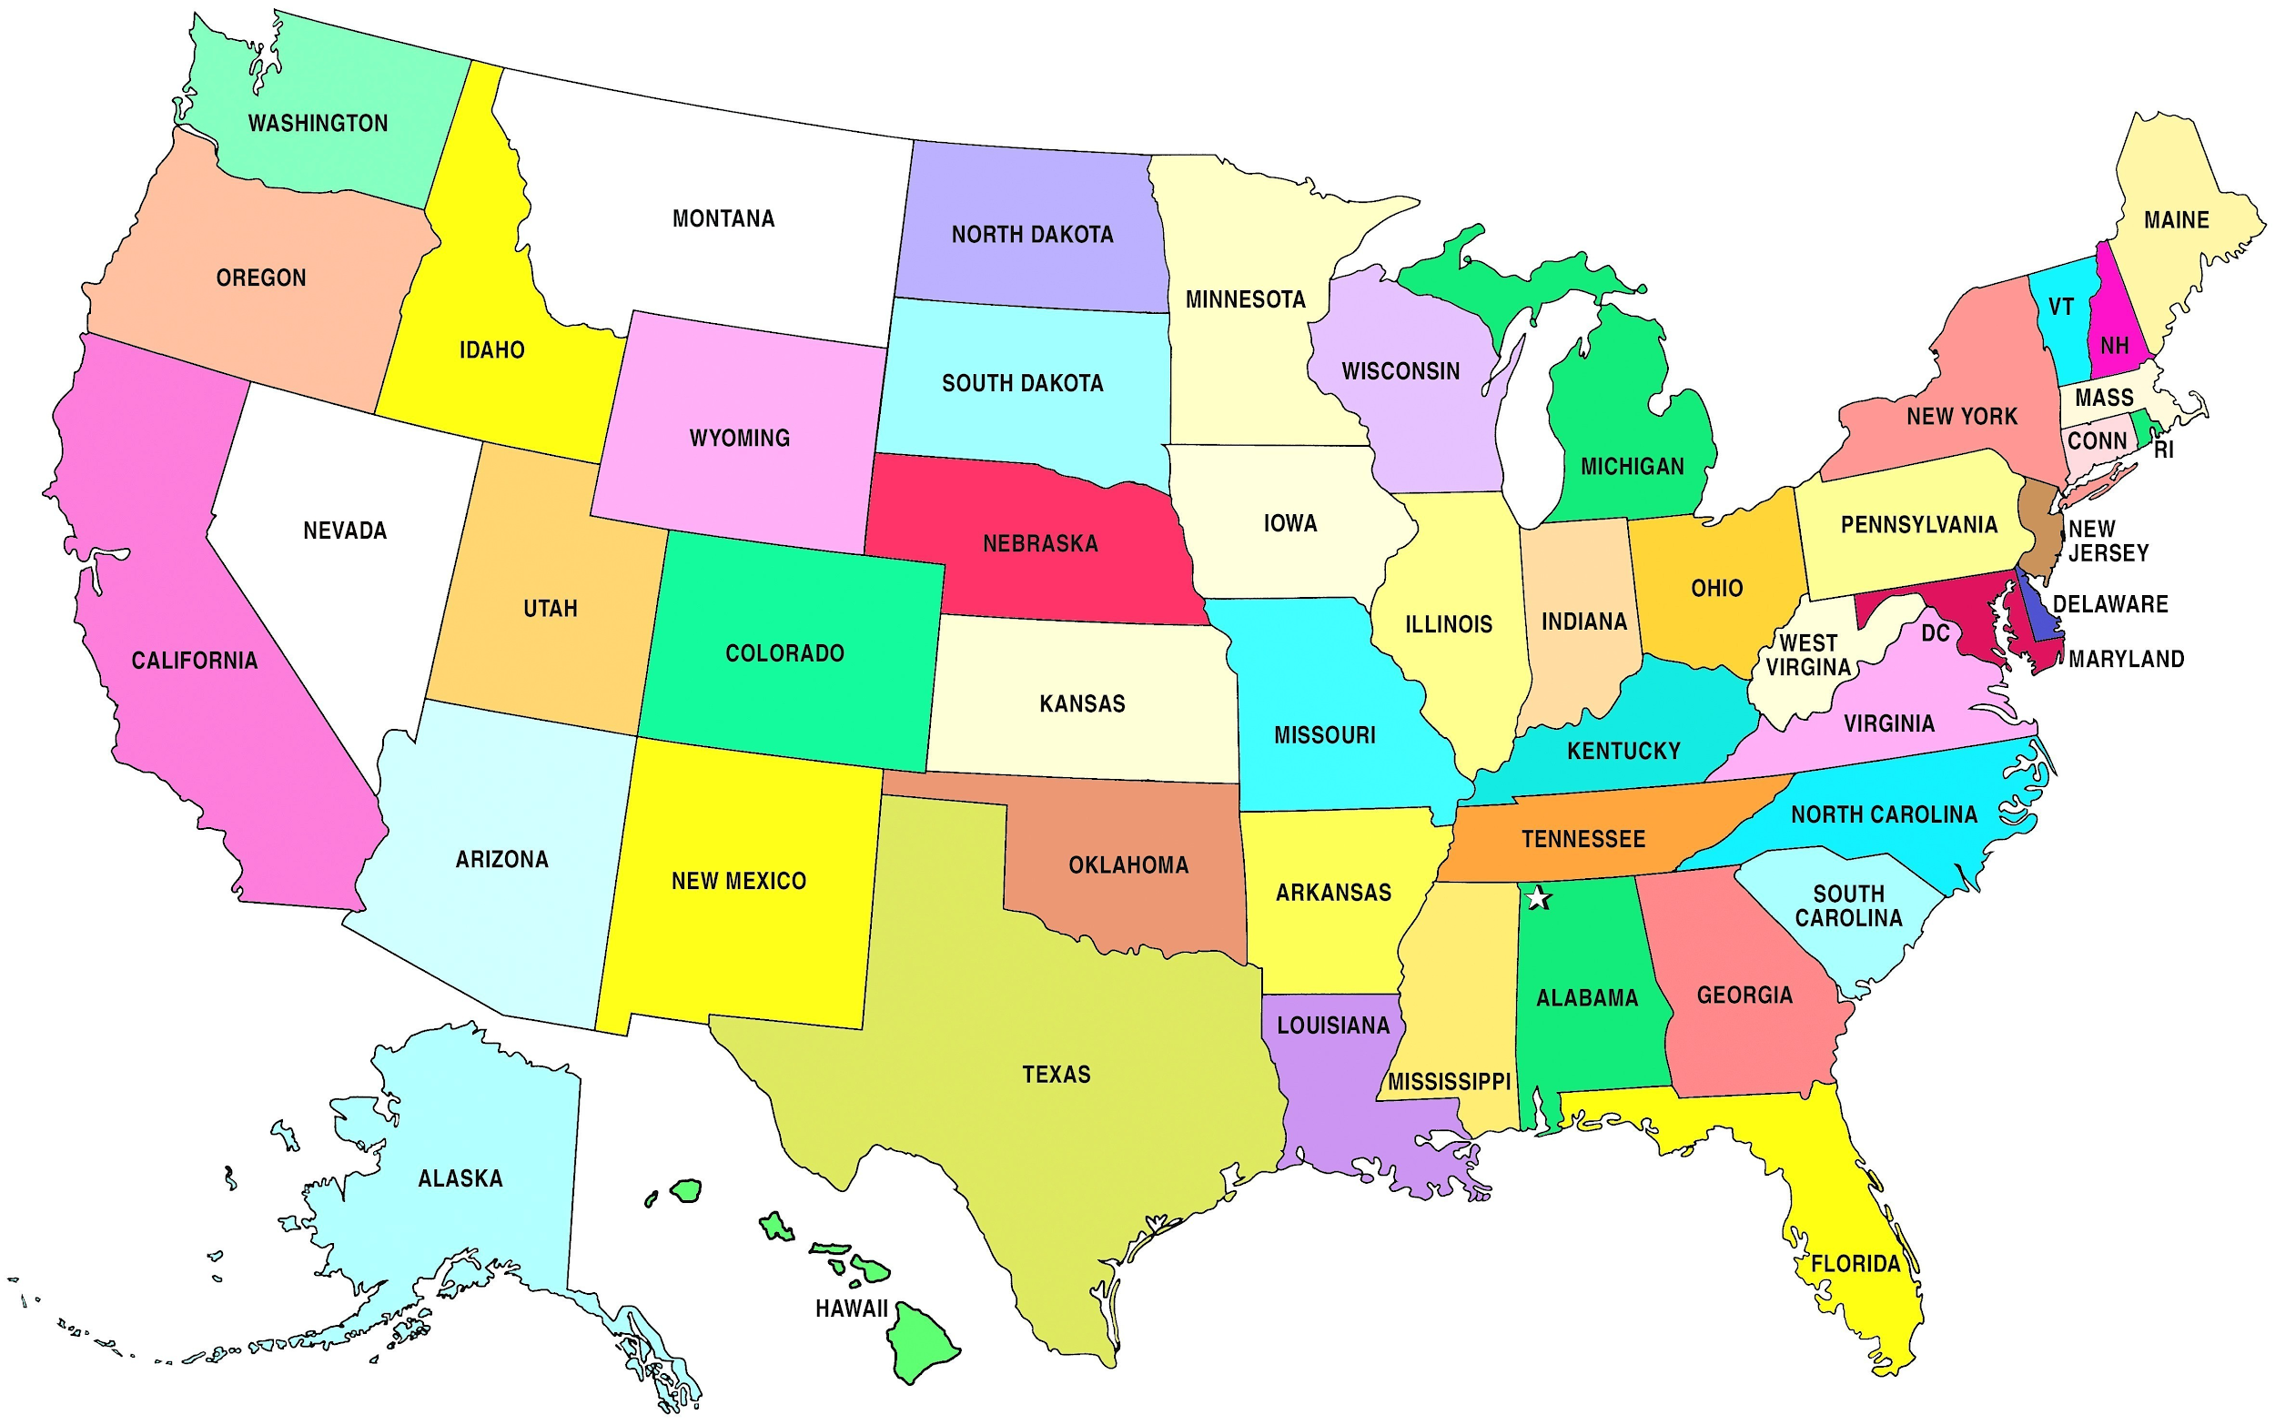
Graph Coloring: Vertex Coloring
Coloring geographical maps
States are nodes
There’s an edge from A -> B if A borders B

Slide 119
Graph Coloring: Vertex Coloring
Scheduling exams
Classes are nodes
There’s an edge from A -> B if a student is in both Class A and Class B
Color the nodes.
Classes of the same color can have exams at the same time.

Slide 120
Graph Coloring: Edge Coloring
Scheduling sports games
Teams are nodes
There’s an edge from A -> B if team A plays team B.
Color the edges
Each edge of the same color is a game that can be played a the same time.

Slide 121
Graph Coloring
Definition
How many colors do we need to color a graph such that no edge connects two vertices of the same color?
How many colors do we need to color a graph such that no vertex has 2 edges of the same color?

Slide 122
Graph Coloring: An Algorithm.
Definition
Create a list of possible colors containing only color 0
Choose a node and assign it color 0
For each uncolored node
Check each neighbor and record its color if it has one
Assign the current node the lowest numbered color no assigned to any of its neighbors
If there are none available, create a new color and add it to the end of the list of possible colors

Slide 123
Graph Coloring: Example
B
C
A
D
H
E
G
F

Slide 124
Graph Coloring:
Graph Coloring: Example
Colors
Color 0
B
C
A
D
H
E
G
F

Slide 125
Graph Coloring: Example
Colors
Color 0
B
C
A
D
H
E
G
F

Slide 126
Graph Coloring: An Algorithm.
Definition
Create a list of possible colors containing only color 0
Choose a node and assign it color 0
For each uncolored node
Check each neighbor and record its color if it has one
Assign the current node the lowest numbered color no assigned to any of its neighbors
If there are none available, create a new color and add it to the end of the list of possible colors

Slide 127
Graph Coloring: Example
Colors
Color 0
B
C
A
D
H
E
G
F

Slide 128
Graph Coloring: An Algorithm.
Definition
Create a list of possible colors containing only color 0
Choose a node and assign it color 0
For each uncolored node
Check each neighbor and record its color if it has one
Assign the current node the lowest numbered color no assigned to any of its neighbors
If there are none available, create a new color and add it to the end of the list of possible colors

Slide 129
Graph Coloring: Example
Colors
Color 0
B
C
A
D
H
E
G
F

Slide 130
Graph Coloring: Example
Colors
Color 0
Color 1
B
C
A
D
H
E
G
F

Slide 131
Graph Coloring: Example
Colors
Color 0
Color 1
B
C
A
D
H
E
G
F

Slide 132
Graph Coloring: Example
Colors
Color 0
Color 1
B
C
A
D
H
E
G
F

Slide 133
Graph Coloring: Example
Colors
Color 0
Color 1
B
C
A
D
H
E
G
F

Slide 134
Graph Coloring: Example
Colors
Color 0
Color 1
B
C
A
D
H
E
G
F

Slide 135
Graph Coloring: Example
Colors
Color 0
Color 1
B
C
A
D
H
E
G
F

Slide 136
Graph Coloring: Example
Colors
Color 0
Color 1
B
C
A
D
H
E
G
F

Slide 137
Graph Coloring: Example
Colors
Color 0
Color 1
B
C
A
D
H
E
G
F

Slide 138
Graph Coloring: Example
Colors
Color 0
Color 1
B
C
A
D
H
E
G
F

Slide 139
Graph Coloring: Example
Colors
Color 0
Color 1
B
C
A
D
H
E
G
F

Slide 140
Graph Coloring: Example
Colors
Color 0
Color 1
B
C
A
D
H
E
G
F

Slide 141
Graph Coloring: Example
Colors
Color 0
Color 1
Color 2
B
C
A
D
H
E
G
F

Slide 142
Graph Coloring: Example
Colors
Color 0
Color 1
Color 2
B
C
A
D
H
E
G
F

Slide 143
Graph Coloring: Example
Colors
Color 0
Color 1
Color 2
B
C
A
D
H
E
G
F

Slide 144
Graph Coloring: Example
Colors
Color 0
Color 1
Color 2
B
C
A
D
H
E
G
F

Slide 145
Graph Coloring: Example
Colors
Color 0
Color 1
Color 2
B
C
A
D
H
E
G
F

